Slide 1

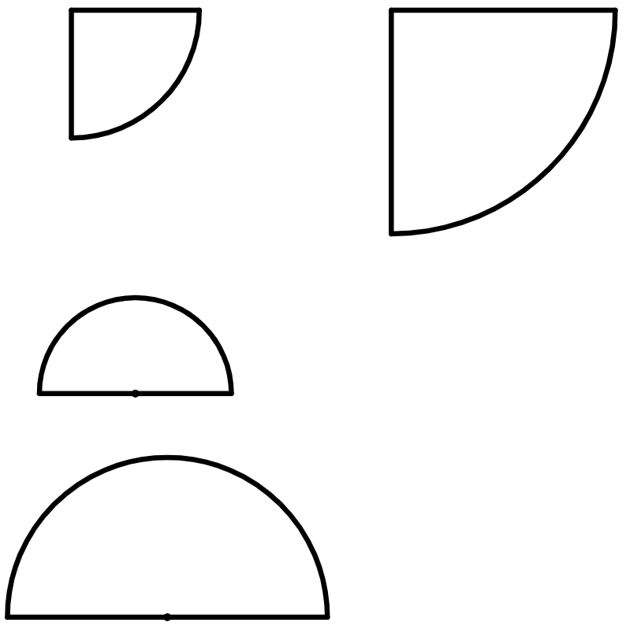
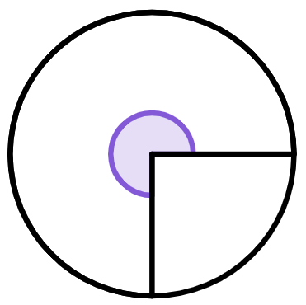
Finding a length in composite shapes
Task A: Finding lengths from areas of circles and sectors
1) Complete the table to find the area of the full circle that the sector comes from.
area of sector | 10π cm² | 25.1 cm² | 31π cm² | 60π cm²
calculation | 10π × 4 | 25.1 × 2 | 31π × 4 | 60π ÷ 3 × 4
area of full circle | 40π cm² | 50.2 cm² | 124π cm² | 80π cm²
2) The area of this quarter-circle is 900π cm².
a) Find the area of the full circle that the sector comes from.
b) Using your answer to part a, complete the method to calculate the radius of this quarter-circle.
area of full circle = π × r²
area of full circle = 3600π
3600π
= π × r²
3600
= r²
60 cm = r
3) The area of a semicircle is 39.3 cm².
Complete the method to calculate the diameter of this semicircle.
4) The area of this three-quarter-circle is 1357.2 cm².
What is the radius of the sector?
area of full circle = π × r²
78.6
= π × r²
25.01…
= r²
area of quarter-circle = 452.4
area of full circle = 1809.6
r = 24 cm (2 s.f.)
5.001…
= r
d
10 cm
≈ d

Slide 2
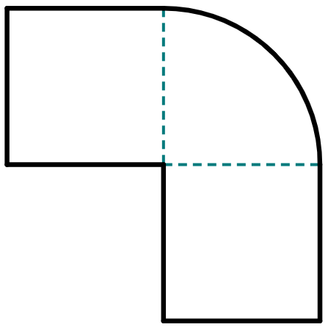

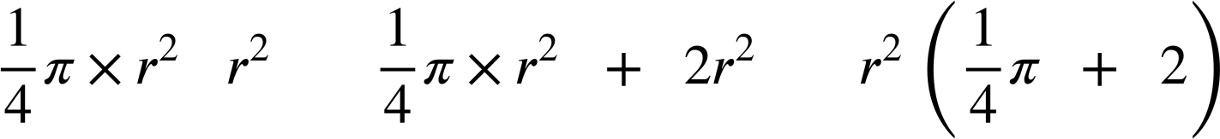
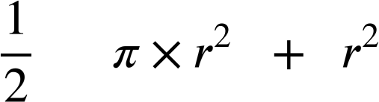
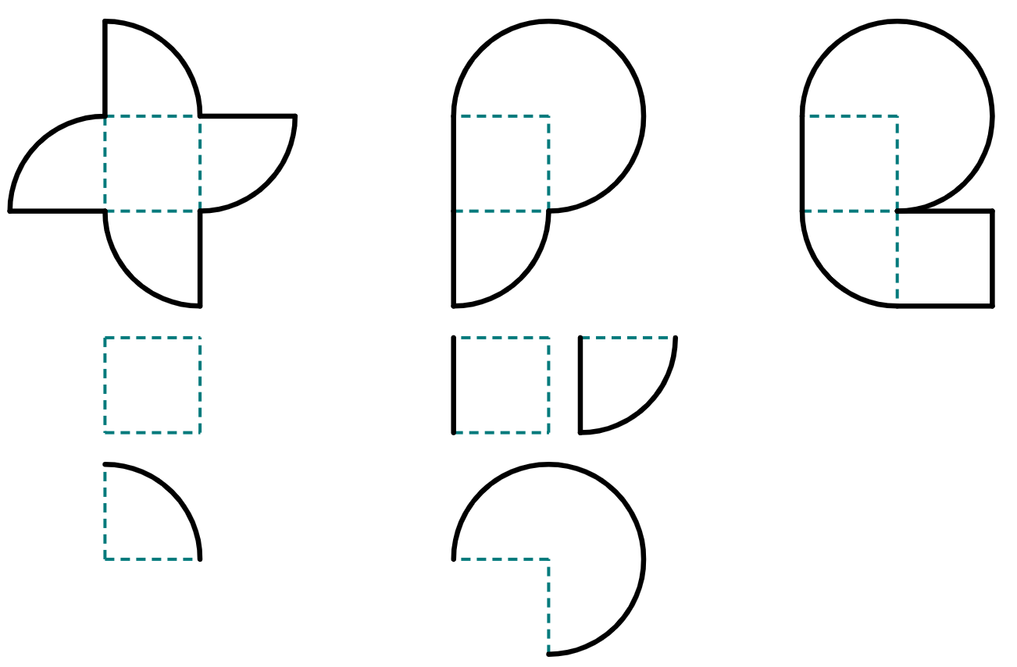
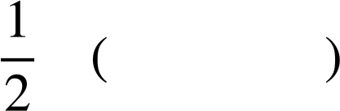
Finding a length in composite shapes
Task B: Finding lengths of composite shapes using algebra
1) This composite shape has an area of 470.7 m².
a) Write down the areas, in terms of r, for the three component parts of this shape.
1
3
area of
1
area of
2
area of
3
2
b) Show by factorising that the area of the composite shape can be written as:
r m
=
=
× 2.785…
c) Complete the calculation to find the radius of the quarter-circle, given to the nearest integer.
× 2.785…
= 470.7
= 169
= 13 m
2) This composite shape has an area of 11 633.7 mm².
Complete the steps to calculate the value of r, giving your answer to the closest integer.
area:
= 11 633.7
circle
square
r mm
factorise:
= 11 633.7
convert π expression into decimal:
4.14…
= 11 633.7
=
divide:
2808.99…
53 mm
square root:
≈
3) This composite shape has an area of 4031 cm².
Find the value of r, giving your answer to the closest integer.
2r² + 𝜋r² = 4031
r cm
r = 28 cm (0 d.p.)
Mathematics in Education and Industry.
v2.3

